Slide 1
Reinforcement Learning
Chapter 1

Slide 2
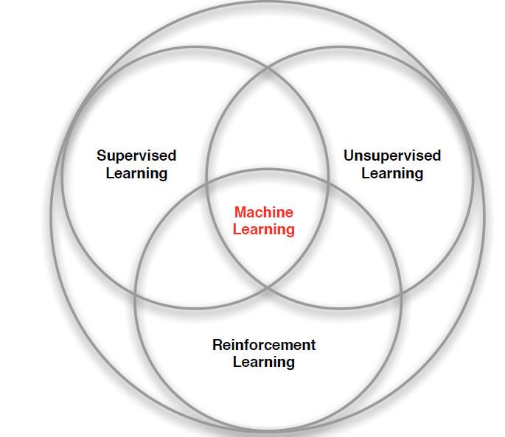
Machine Learning
Notes:
RL – is the learning model (called agent) training itself. You don’t give it label data to train it, instead you give it a function where by it knows whether an action it took is good or bad and that’s it, from there it learns all on its own.
Unsupervised learning – learning without a teacher (instructions) sort of set data into piles, find patterns in the data (put circles over here, triangles over there)
Supervised learning –It’s like Neural Network school, you are the trainer and you are training your model to recognized patterns so that when you release it into the wild it can continue to recognize patterns into data that it has never seen before.

Slide 3
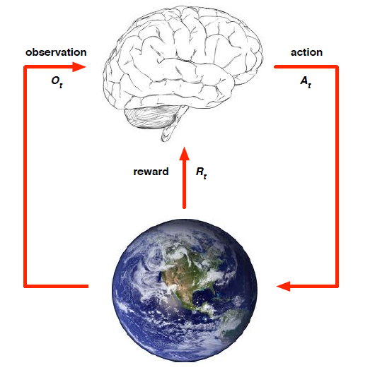
Elements of Reinforcement Learning (RL)
RL is the science for decision making (optimal way to make decisions)
What makes RL different from other machine learning paradigms?
There is no supervisor, only a reward signal (good/bad)
Feedback (good/bad) is delayed, not instantaneous
Time really matters (sequential, non labeled data)
Agent’s actions affect the subsequent data it receives (moving
left vs right)
The goal of reinforcement learning is to discover an optimal policy π ∗ that maps states (or observations) to actions so as to maximize the expected return J, which corresponds to the cumulative expected reward.
Notes:
There is no supervisor, only a reward signal: No one tells us the right actions to take, instead is a trial and error paradigm…
Feedback is delayed, not instantaneous: you make a decision now, and you get the feedback later whether it was a good or bad decision.
Time really matters (sequential, non i.i.d data -> Not learning from data set such as supervised learning): one step after another and another the agent gets to make decisions, pick actions, see how much reward the agent gets and then optimize rewards to get the best possible outcomes.
Agent's actions affect the subsequent data it receives: agent gets to move around (if robot moves to one side to other side of room it gets to see different things and get different rewards). So, the agent is actually influencing the data that it sees.
Overall, RL tries to optimize a sequence of decision via a reward function.

Slide 4
Major Components of RL
An RL agent may include one or more of these components:
Policy: agent's behavior function
Value function: how good is each state and/or action in the long run (prediction of rewards)
Reward Signal: signal indicating what are good/bad events for the agent in the immediate sense
Model (optional): agent's representation of the environment

Slide 5
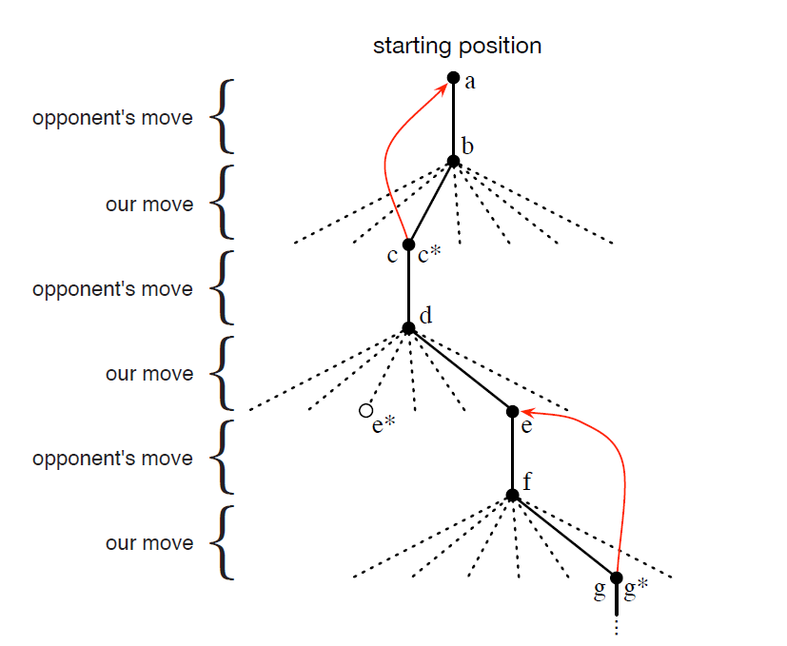
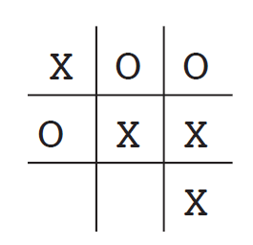
RL Example: Tic-Tac-Toe
Notes:
Policy – map from states to actions

Slide 6
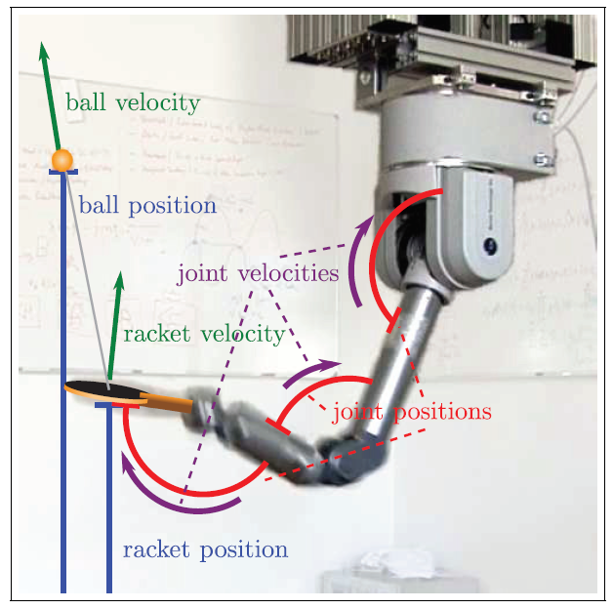
RL Example: Robotic Arm
Training a robot to return a ball over the net
State s: current internal arm observations (specifying ball pos/vel and the internal dynamics of the joint pos/vel)
Actions a: torques sent to the motors or the desired accelerations
Policy function π (maps states to actions):
generates the motor commands (i.e. the actions)
based on the incoming ball and current internal arm observations (i.e. the state).
The reward function could be based on the success of the hits as well as secondary criteria such as energy consumption.
Notes:
Policy – map from states to actions

Slide 7
Back Up Slides

Slide 8
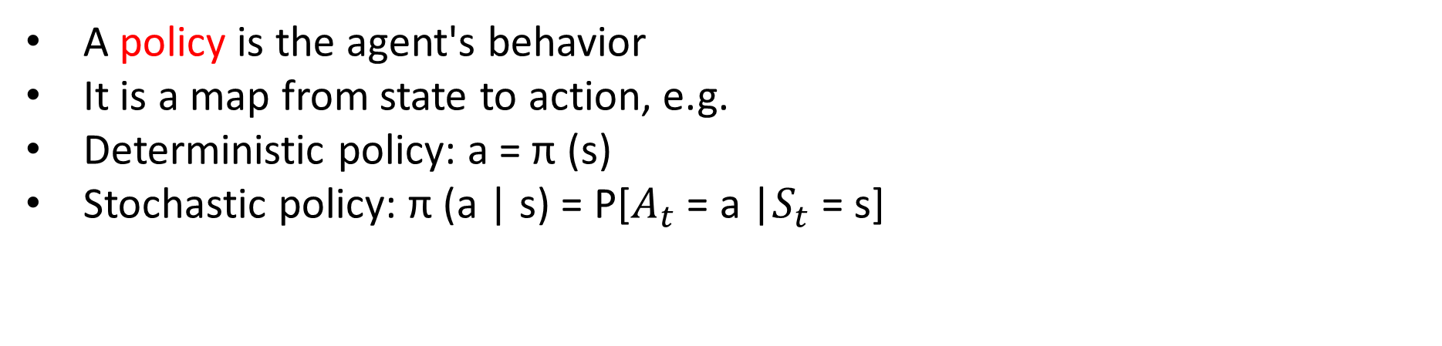
Policy
A policy is the agent's behavior
It is a map from state to action, e.g.
Deterministic policy: a = π (s)
Stochastic policy: π (a | s) = P[$A_{t}$ = a |$S_{t}$= s]
Notes:
Stochastic: Probability of an agent taking an action given the current state

Slide 9
Value Function
Value function is a prediction of future reward
Used to evaluate the goodness/badness of states
And therefore to select between actions, e.g.
Ex: in the case of the helicopter, if it executes a particular trajectory.. How much reward will that trajectory get?
Helpful quantity for optimizing behavior!
Notes:
The reward function of a policy tells us how much reward to expect to get going into the future…
Should I take the trajectory that will give me 16 pts in reward or the trajectory that gives 25pts in reward?
The goal of the agent is to maximize the sum of the rewards received by the environment, namely the
return R = Pt t rt . The discount factor gamma (0, 1] is to guarantee the convergence of the sum if the time horizon is not finite (infinite horizon).

Slide 10
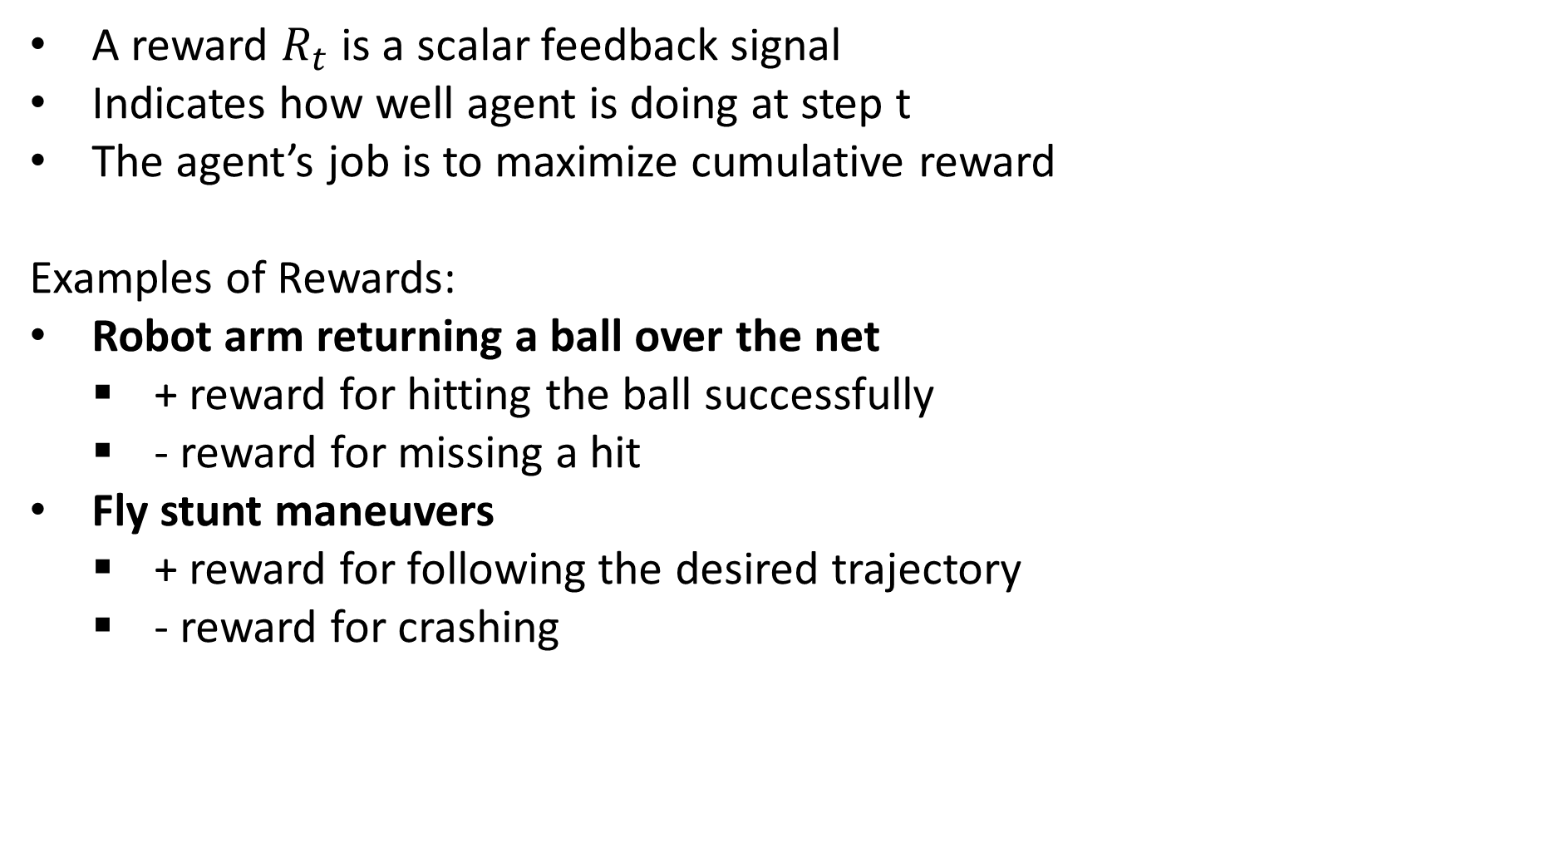
Rewards
A reward $R_{t}$ is a scalar feedback signal
Indicates how well agent is doing at step t
The agent’s job is to maximize cumulative reward
Examples of Rewards:
Robot arm returning a ball over the net
+ reward for hitting the ball successfully
- reward for missing a hit
Fly stunt maneuvers
+ reward for following the desired trajectory
- reward for crashing

Slide 11
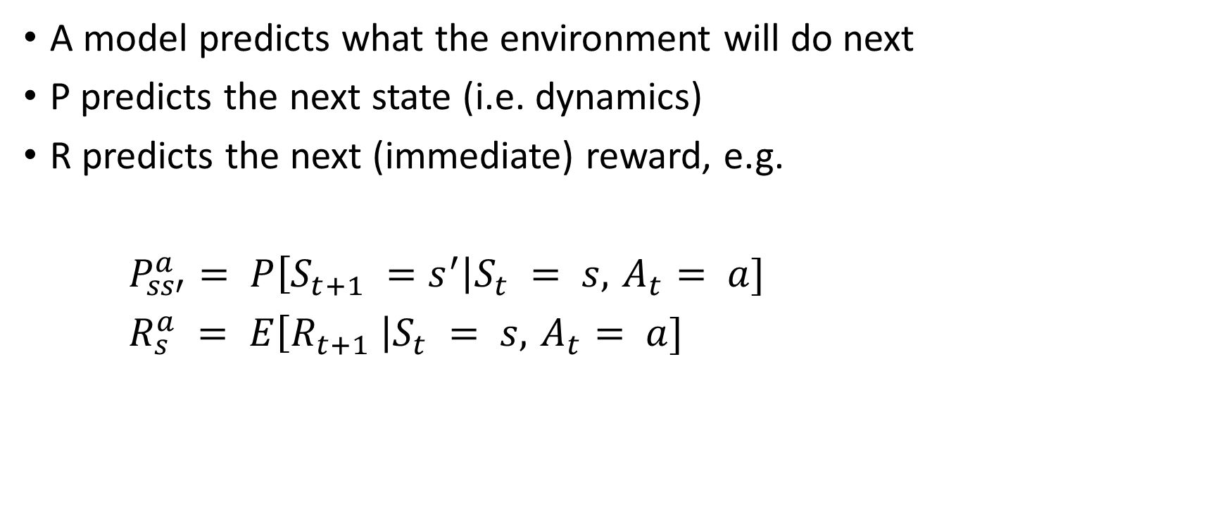
Model
A model predicts what the environment will do next
P predicts the next state (i.e. dynamics)
R predicts the next (immediate) reward, e.g.
$P_{ss′}^{a}= P\left[S_{t+1} =s^{′}\right|S_{t} = s, { A}_{t} = a]$
$R_{s}^{a} = E\left[R_{t+1} \right|S_{t} = s, { A}_{t} = a]$
State transition model
Reward model
***This is an optional requirement
Notes:
The probability of being in the next state given the previous state and action
Expected reward given the previous state and action
If you are the agent, the environment could be the laws of physics and the rules of society that process your actions and determine the consequences of them.

